Slide 1
AskCCI Student Assist Bot
By: Bhakthi Liyanage, Rachel Conforti, Dedeepya Ramineni, Sree Gauthami Gundaram, Aparna Reddy Pothula
Notes:
Rachel
5-8 Sree Gauthami
9-12 Dedeepya
13-15 Aparna
Demo- Bhakthi

Slide 2
Project Objective & Overview
Our objective was to create a artificial intelligence chat bot that will simplify the University of North Carolina at Charlotte FAQ page for College of Computing and Informatics.
Our bot will allow you to ask the bot questions 24/7, 365 days a year. Preventing student frustration and preventing CCI staff from answering questions that have already been asked.
To start our bot, you have to click on the symbol to begin to conversation and from there the bot will answer any of our 10 use cases or prompt you to call the desk help-line.
Notes:
rachel

Slide 3
Technology Used
Front End
We used HTML, Javascript, CSS, jQuery
Back-end
We used Rasa Bot Framework, Python 3.6, YAML, FastAPI, and web server framework
Hardware
OS: Linux 20.04, Memory: 16G, HDD: 256G
Notes:
rachel

Slide 4
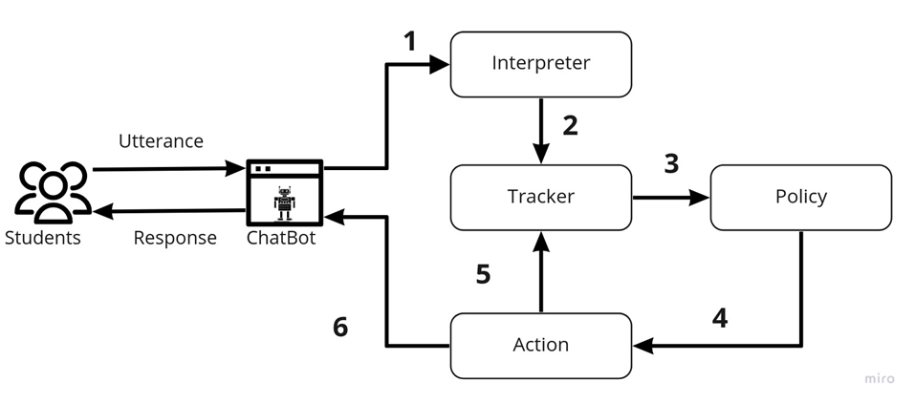
Rasa Bot Functionality
The message is received and passed to an Interpreter, which converts it into a dictionary including the original text, the intent, and any entities that were found.
The Tracker keeps a track of conversation. It receives the incoming utterance and it’s metadata, and stores them in the tracker store.
The Policy receives the current state of the tracker
The Policy determines the next Action based on the user stories and rules
The Actions is tracked in the tracker
The response is sent to the user
Notes:
Talk about the steps that we are putting down. - rachel

Slide 5
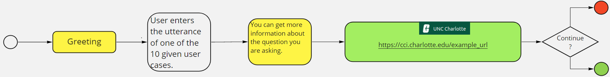
User Stories
Master Program contact details
PhD program contact details
Masters admission requirements
PhD admission requirements
Fellowship/internship opportunities
Available grants
Tuition fees
Clubs/activities
Available research information
Job opportunities/information
Generalized flow diagram of the user stories
Notes:
Sree

Slide 6
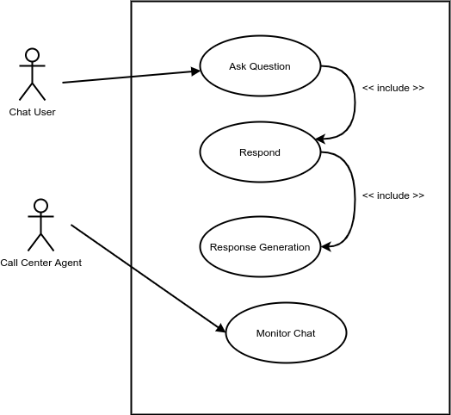
Use Case Diagram
Notes:
Sree

Slide 7
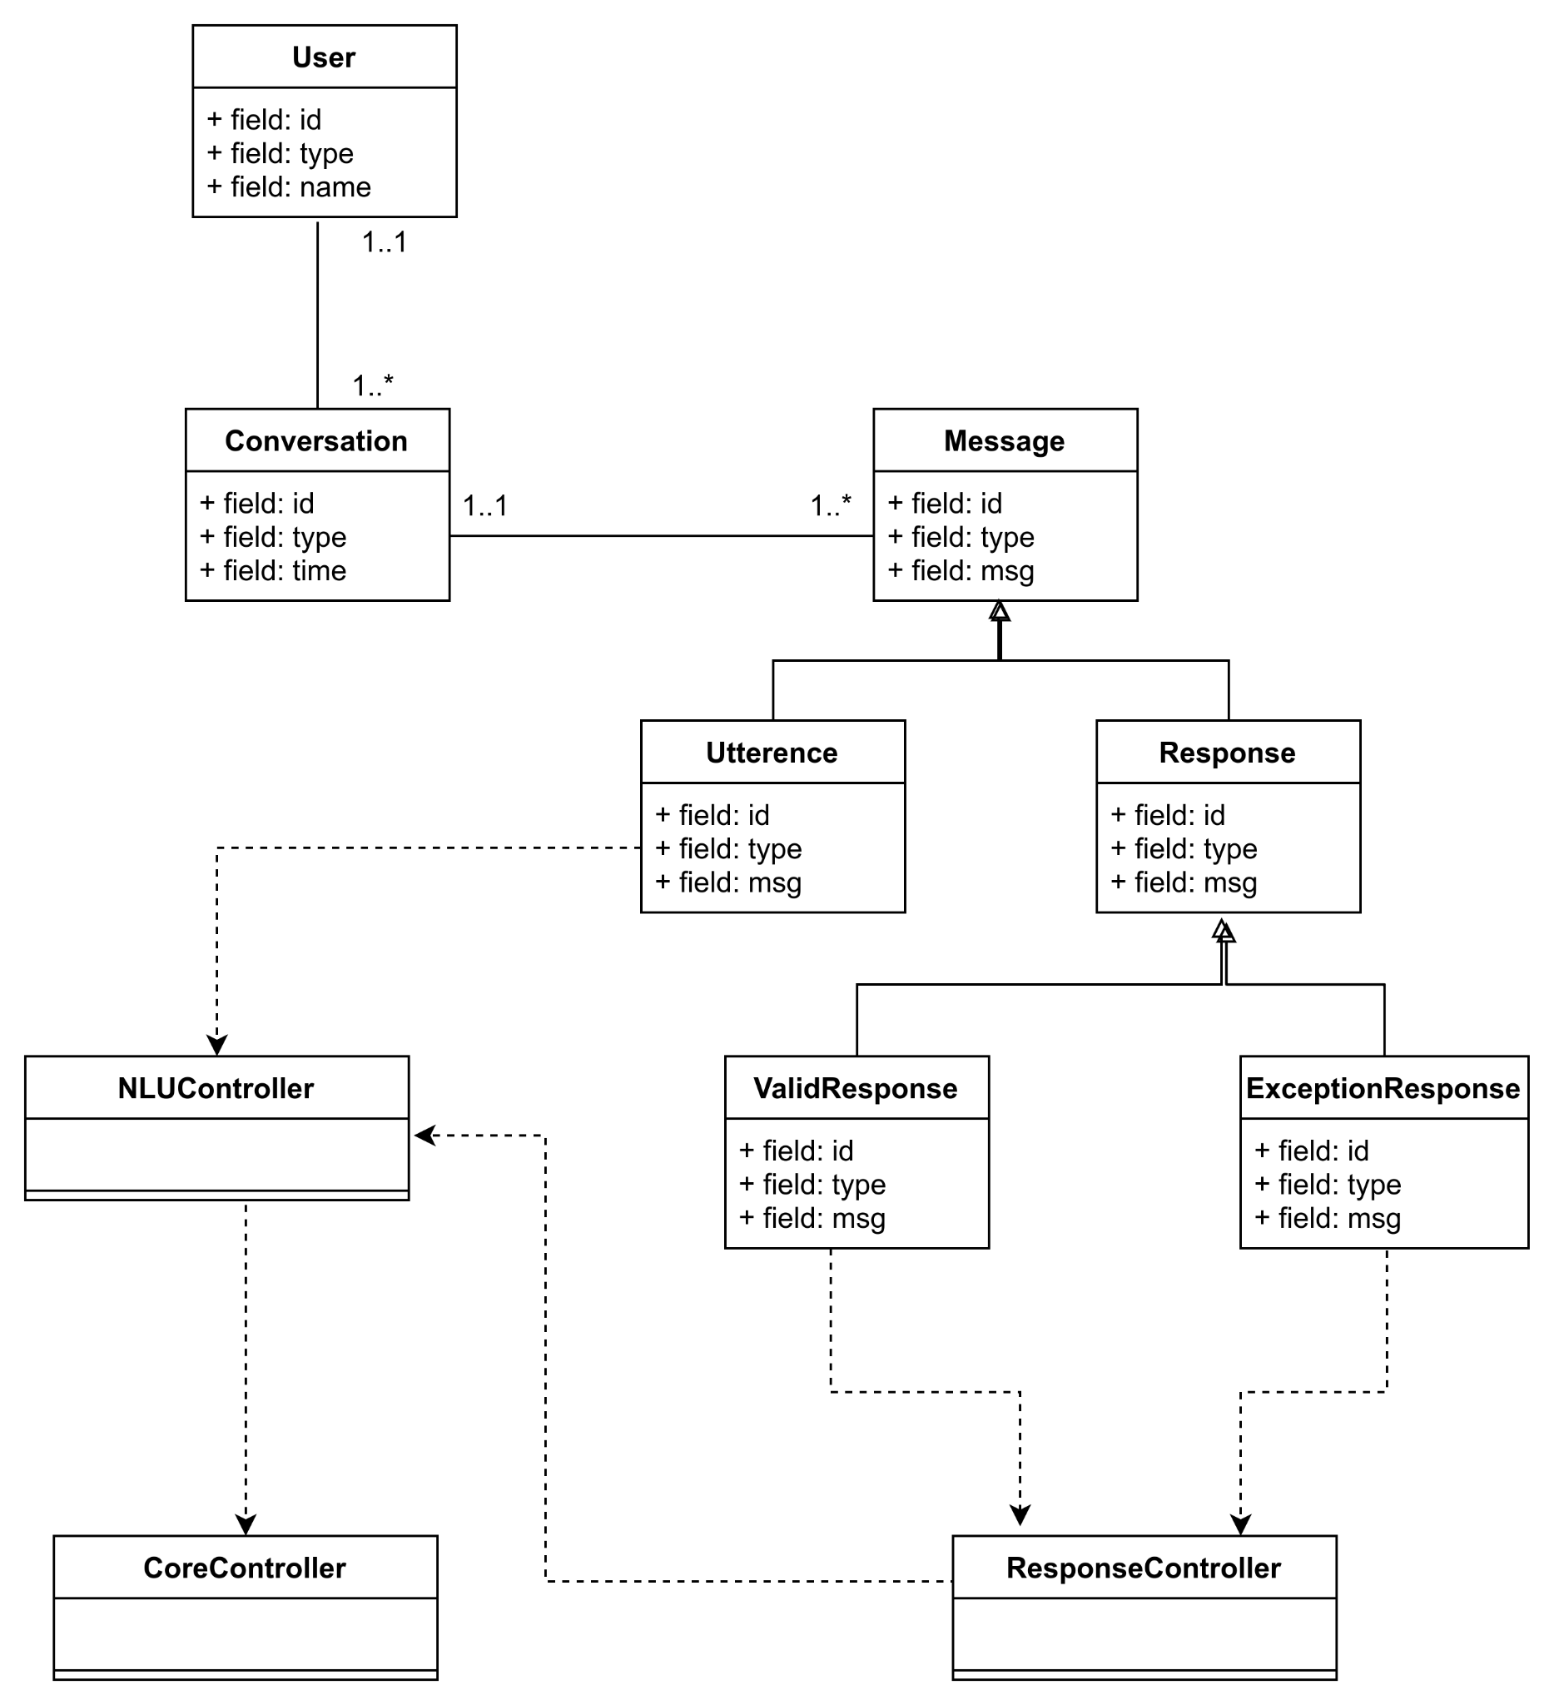
Class Diagram
Notes:
Sree

Slide 8
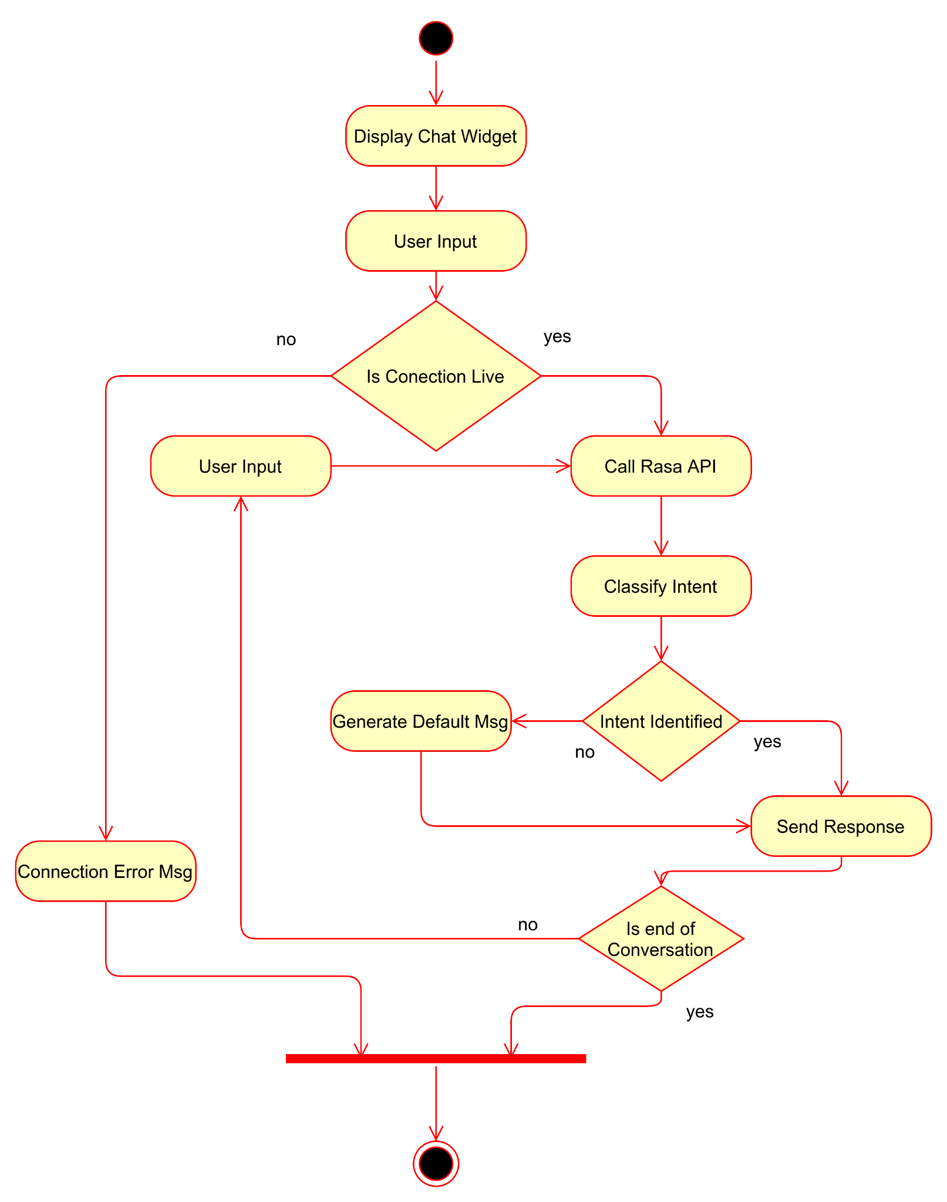
Activity Diagram
Notes:
Sree

Slide 9
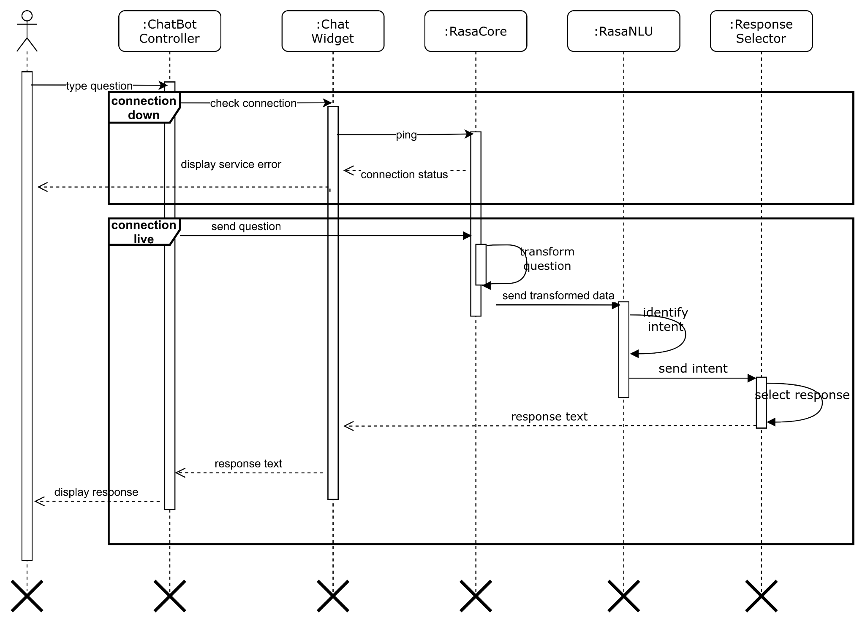
Sequence Diagram
Notes:
Dedeepya

Slide 10
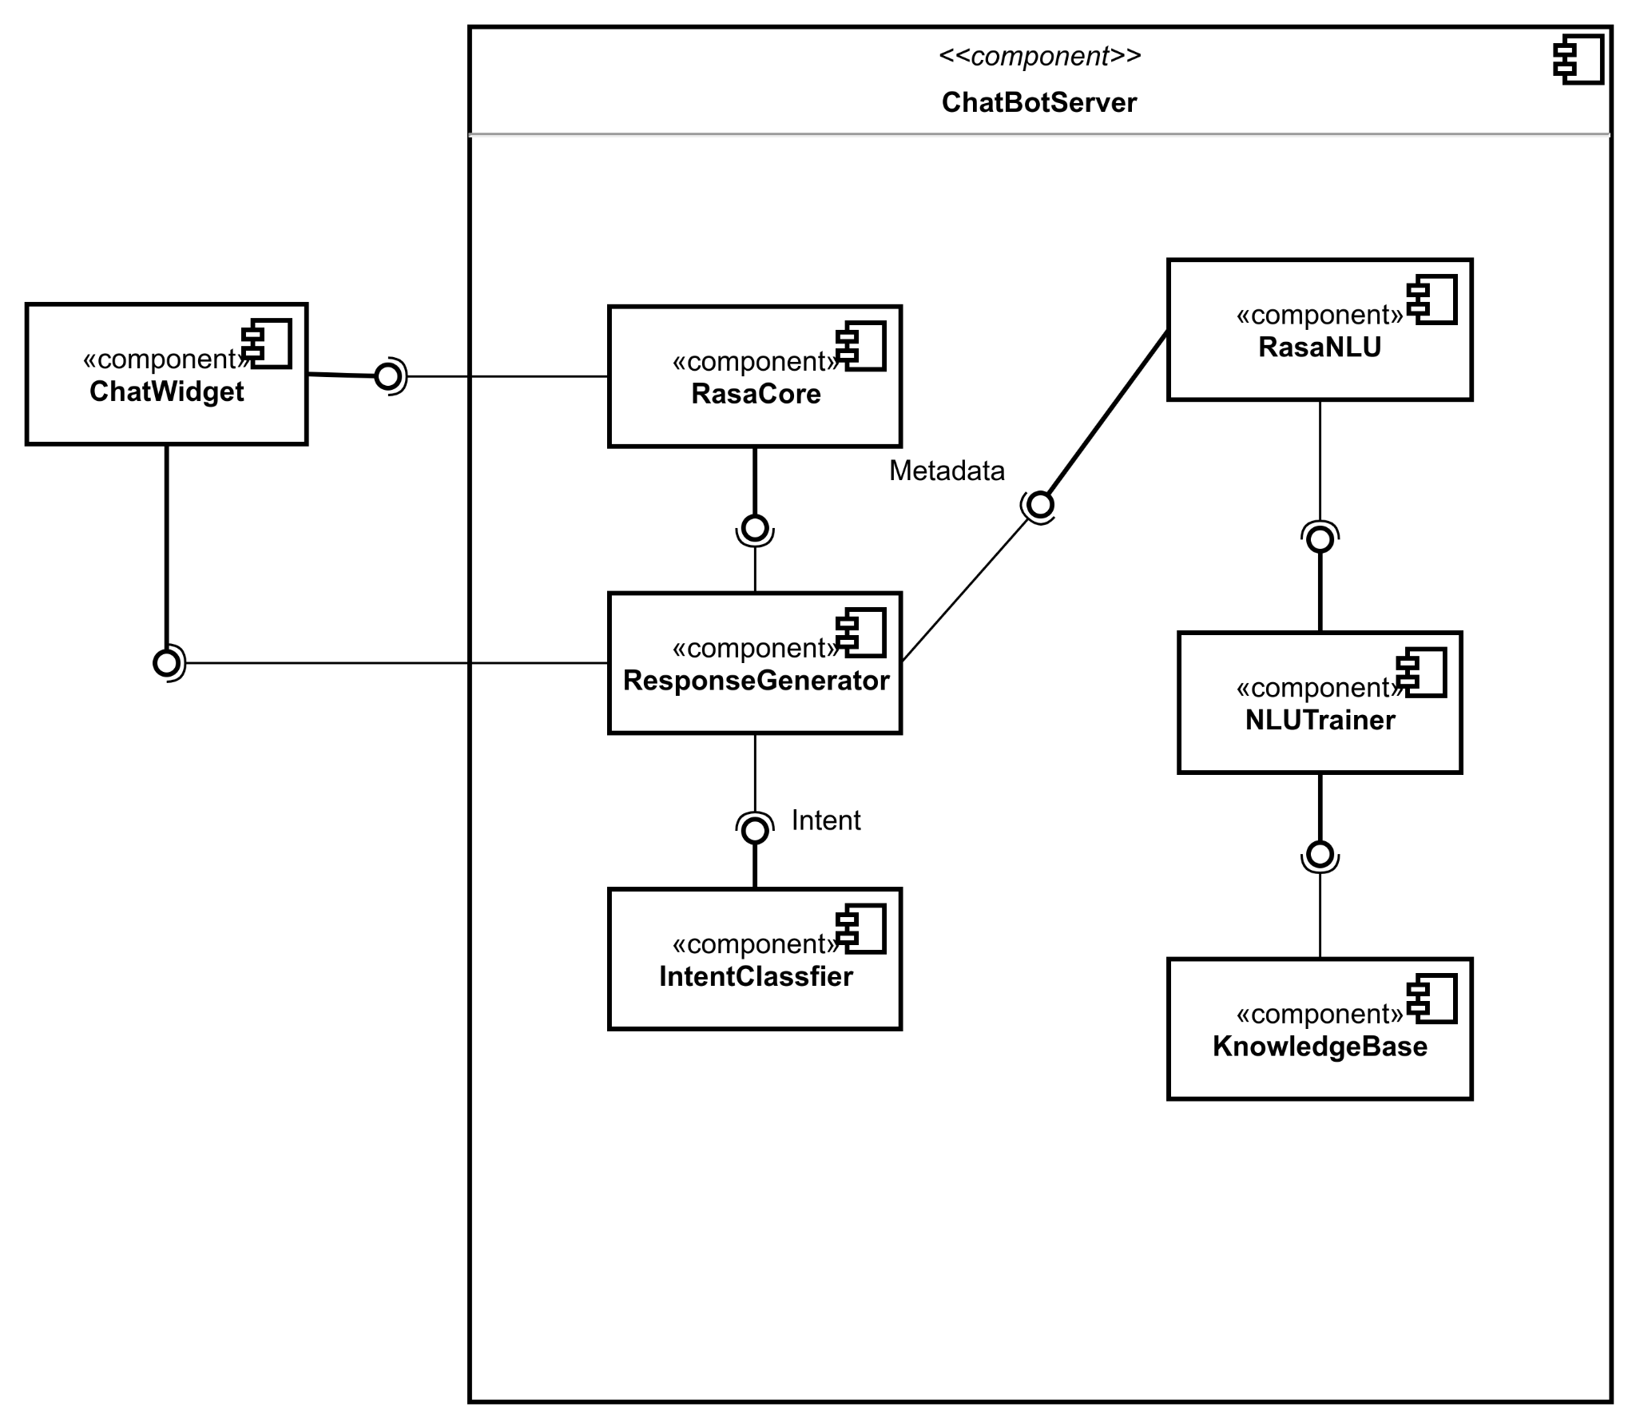
Component Architecture
Notes:
Dedeepya

Slide 11
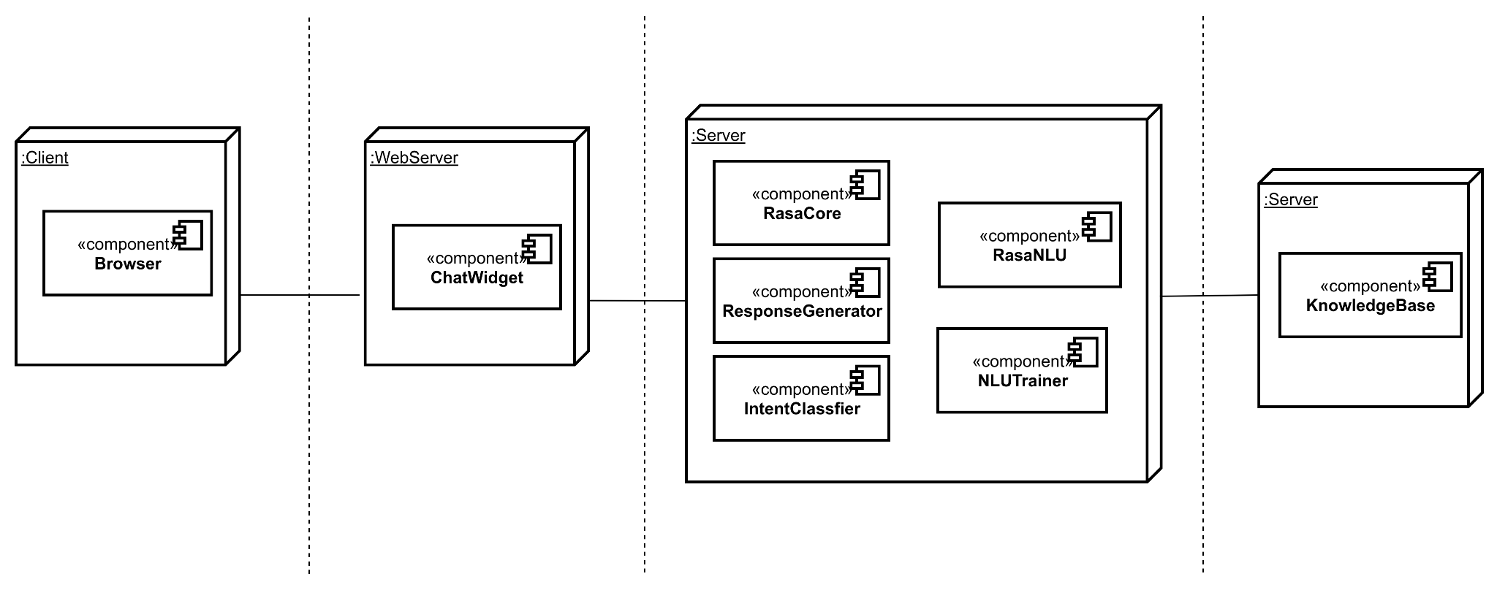
Deployment Diagram
Notes:
Dedeepya

Slide 12
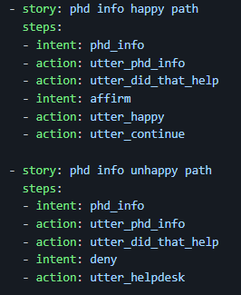
Happy versus unhappy Paths
A happy path recognizes the intent such as the user is asking for PhD admissions information and subsequently inform the user of the information and ask the user is that helped.
A unhappy path will result in the bot informing to contact CCI through email or their phone number.
Notes:
Dedeepya

Slide 13
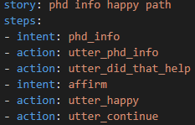

How it Connects:
User asks: “Where can I find information about the PhD program?”
The bot will recognize the [PhD](degree) key words and path it to the correct story.
Then it will follow the action, utter_phd_info which is where our link is stored.
The bot will ask if the user is satisfied with the answer and if not will advise the student to contact the CCI office.
or
Notes:
Aparna

Slide 14
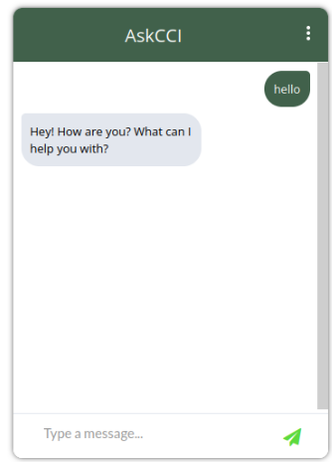
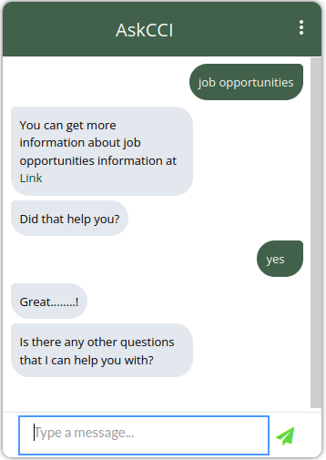
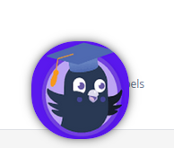
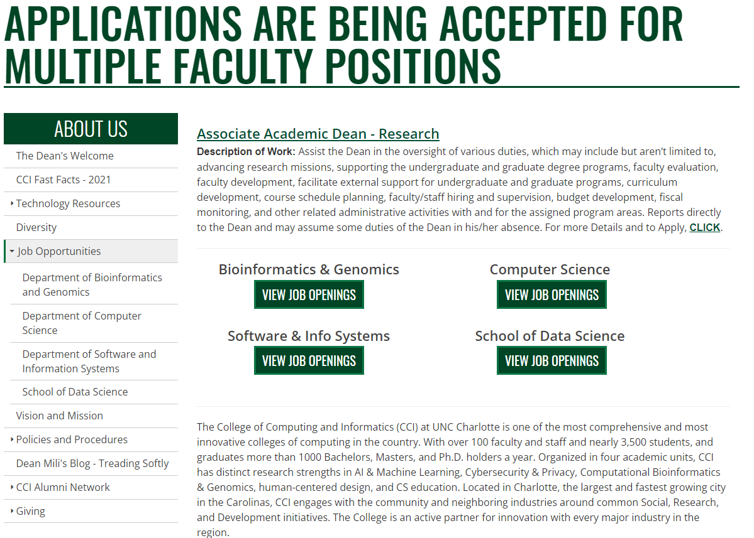
Screen Shots
When you load up the demo you will see this, click it and the bot will greet you!
Once the bots greets you, you are free to ask the bot any of the 10 use cases!
Can ask something simple like ‘job opportunities’ and the bot will link you the corresponding page.
The linked page by the bot!
Notes:
Aparna

Slide 15
Future Improvements
We would like to add more then the 10 use cases we have done currently. Ideally expanding all of the CCI page.
More rigorous testing of the bot performance. Using regression testing against the user stories would ensure a quality AI chat bot before production.
The current implementation is hosted on dummy web page. But, in the future we will add the bot on the AskCCI page
Notes:
Aparna

Slide 16
Demo

Slide 17
Q & A

Slide 18
Thank you!

